Slide 1
Viva presentation
Structural Pruning for Speed in Neural Machine Translation
Maximiliana Behnke
Notes:
Hello everyone!
My name is Maximiliana Behnke. It is my pleasure to invite you to my pre-viva talk today.
I will present my PhD research on structural pruning for speed in neural machine translation.
I hope that by the end of this presentation, which should take about 40 minutes, you will learn something cool about pruning! Let us begin.

Slide 2
PROBLEM
MODEL SIZE
Best-quality models come at a computational cost.
FRONTIER
Bad baselines obscure the actual advantages.
optimisation
Speed-up is difficult to achieve.
TRANSLATION
NMT is expensive to experiment with.
Notes:
I knew from the beginning of the first year of my PhD that I wanted to explore the efficiency optimisation side of neural networks but I wasn't sure what topic exactly to pursue.
I read a bunch of papers, talked with my supervisor, trying to see which research field had an unexplored niche.
A huge demand for optimisation quickly solidified in my mind. This is because we build larger and larger models to keep improving quality, which is not getting cheaper by any means.
I remember getting frustrated, because even though the optimisation is a really hot subject in deep learning, in many cases it is severely lacking.
Most research papers use outdated or too small datasets combined with barebone unoptimised architectures.
This obscures the actual potential advantages new methods may have in practice. In many cases, you're better off using whatever methods you already have in your sleeve.
To be blunt: optimisation is really difficult and achieving actual speed-up is even more so. This is evident in many papers that provide only theoretical numbers or none at all.
The problem is even more evident in machine translation. Due to the nature of the task, NMT is expensive to train, making it not a popular research direction. It is often neglected in favour of image recognition, that trains much much faster.

Slide 3




Parameter Pruning
Slow
Expensive
Biased
Limited
sparse kernels
to perform
speed analysis
towards bad baselines
Notes:
My interest peaked at parameter pruning.
It is a really well-explored research field with many papers. However, reading through those I kept thinking
'if pruning is so great and has so many supposedly awesome results, how is it we are not using it in practice when we develop machine translation models? we just use smaller architectures, that's all!'
First and foremost, sparse kernels required for matrix multiplications are really difficult to optimise.
In practice, sparse matrices are faster only if they are really sparse, like above 90%. Aggressive pruning damages quality and may not be worth the effort.
Pruning is also expensive. Depending on an algorithm, a model may need to be trained twice or even multiple times. This is something unatainable in machine translation, where a model is already training for weeks, so we cannot afford to train for longer.
As I already mentioned, most of the research is biased towards bad baselines, and it is no different in pruning. It is much easier to prune a large model than a state-of-the-art small architecture.
Due to the inefficiency of sparse solutions, speed analysis is often omitted or done in theoretical FLOPs that do not reflect the actual speed-up of a model.

Slide 4
Thesis statement
Make NMT models faster by exploring structural pruning methods.
Advance the state-of-the-art with simple pruning methods that result in smaller but still dense architectures.
Notes:
The goal of my thesis was to make machine translation translate faster through structural pruning methods. I will show you that it is possible to advance the current state-of-the-art with simple pruning methods that result in smaller but still dense architectures.
Speed-up is easily achievable as we do not need any sparse operators.

Slide 5
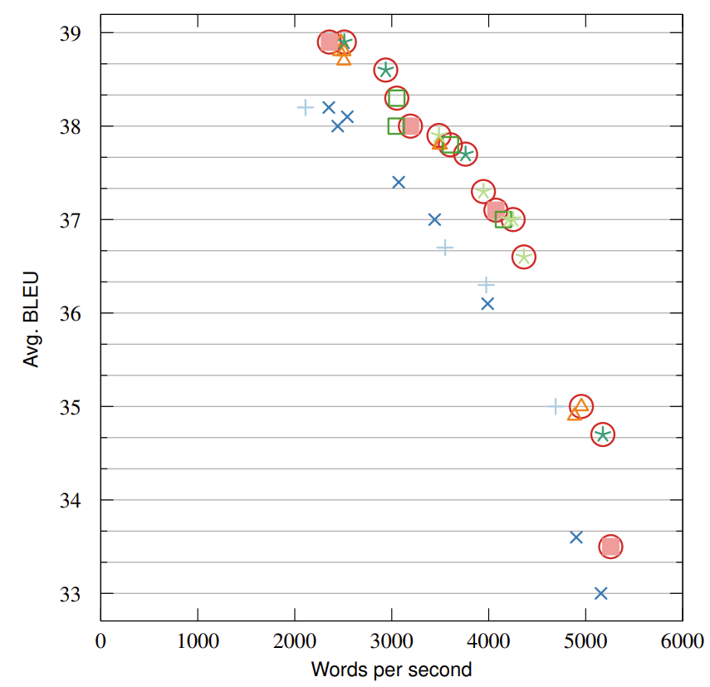









PARETO TRADE-oFF
←Pruned
Baselines &
Trained from scratch →
Pruning pushes the state-of-the-art forward.
Notes:
Before I jump right into my research, I would like to introduce you to the concept of Pareto optimality and spoil you some of the future results as an appetizer.
Here we have a graph that plots the trade-off between translation quality in BLEU and inference speed expressed in words per second.
In yellow I highlighted the models pruned structurally by methods I am going to show you soon.
Theoretically, the best possible model would be in the upper right corner of this graph as it would be the best and the fastest it can be.
As you can see, the pruned models lead the Pareto frontier, providing the best trade-off between qualiy and speed.

Slide 6
OVERVIEW
LTH
GL
AR
Lottery Ticket hypothesis
GROUP LASSO
AIDED REGULARISATION
Notes:
There are three key chapters in my thesis that I will talk about today.
The first one is about the Lottery Ticket Hypothesis, a well-known pruning method that I expand to work in a block-sparse setup.
Next is about group lasso, a simple structural regularisation technique that I utilise to compress a neural model early into training.
Last but not least, I investigate a brand new research direction with aided regularisation, which steers a model to target the most prunable layers and ignore those deemed too important.

Slide 7
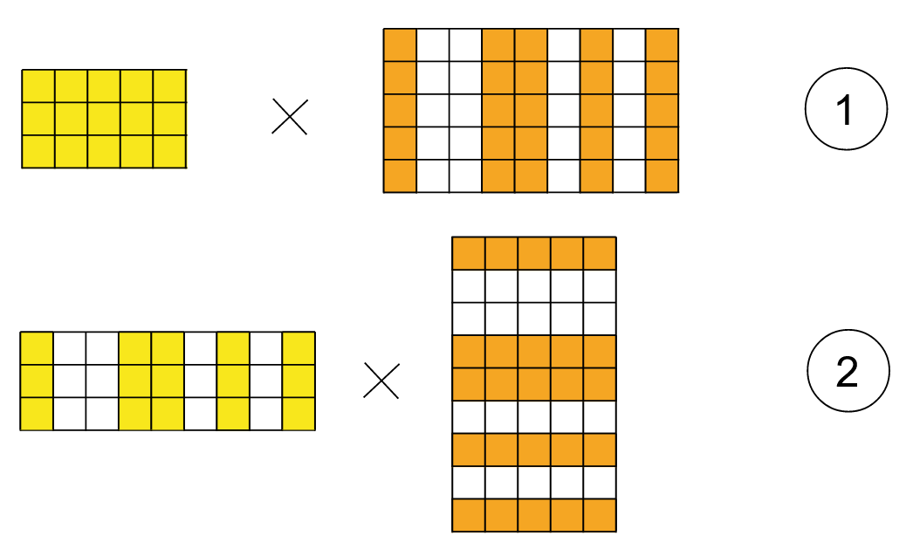
Pruning a transformer architecture:
Feedforward
layers

Slide 8
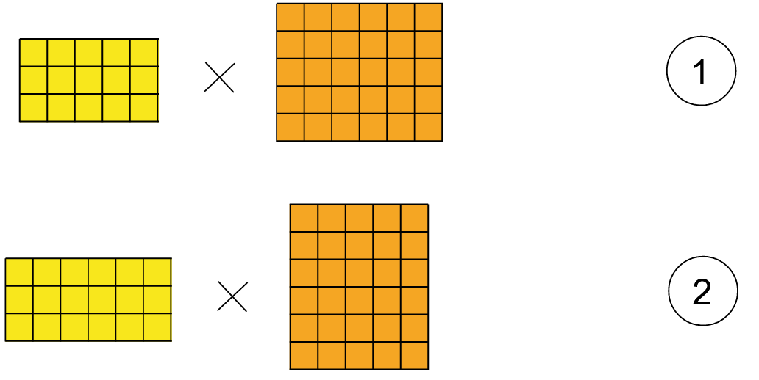
Pruning a transformer architecture:
Feedforward
layers

Slide 9
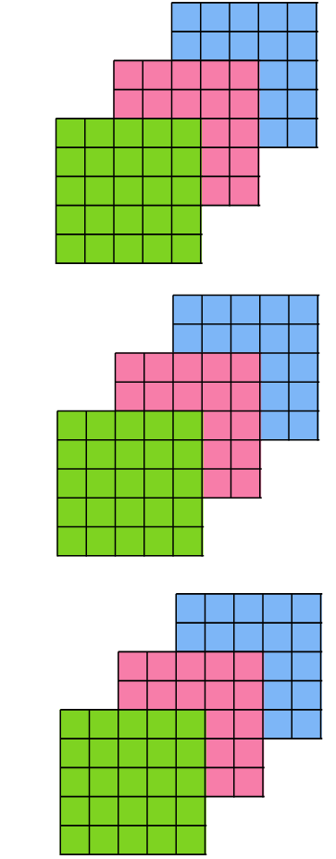
Pruning a transformer architecture:
Attention
heads

Slide 10

Pruning a transformer architecture:
Attention
heads

Slide 11
Lottery ticket hypothesis
Notes:
Now with that out of the way, let's begin with my work on a structural lottery ticket hypothesis.

Slide 12
Attention pruning
Structural
REDUNDANT
PRUNABLE
Similar distributions across layers (Xiao et al., 2019).
No significant linguistic roles (Voita et al., 2019).
Many heads can be removed at test time (Michel et al., 2019)
Most heads are useless and can be pruned (Voita et al., 2019)
Notes:
In this research, I focus on pruning heads in the attention mechanism. As I explained just now, each head is a collection of small submatrices that can be easily removed from a model.
There has been some insight into attention redundancy presented by other researchers.
They report that many attention layers share similar distributions.
Also, many heads do not play any significant linguistic roles, suggesting that they may be approximated, reused or pruned, which interests me the most.
Indeed, many heads are reported to be useless and can be removed with negligible impact on quality importance.

Slide 13
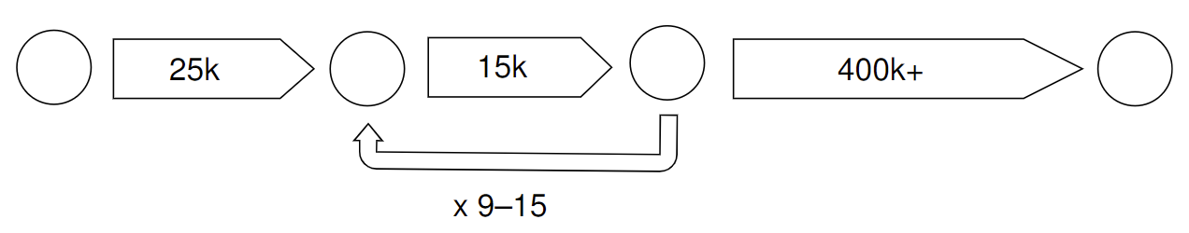
Lottery ticket hypothesis
(Frankle et al., 2019) coefficient-wise
STRUCTURAL pruning
Search for a winning ticket
A subnetwork that keeps the quality of the full network when trained in isolation.
1
2
3
4
Iterative LTH with late resetting
Pretrain, prune and reset in a loop, converge.
Notes:
I chose to tackle the attention pruning problem with the lottery ticket hypothesis approach.
The hypothesis states that a randomly initialised neural network contains a subnetwork that, when trained in isolation, reaches the potential of the full network.
This lucky mix of parameters is a winner of the initialisation lottery and the goal of is to find such attention heads and prune the rest.
I use the lottery ticket hypothesis in its iterative form with late resetting.
It consists of the following steps:
First, we initialise and pretrain a model for a short time to stabilise it.
Next, we enter a loop of training a model partially, pruning parameters and resetting the rest of parameters back to the starting checkpoint.
This loop is repeated until we are satisfied with the sparsity of a model.
Finally, we allow the sparse network to to train freely until convergence.

Slide 14
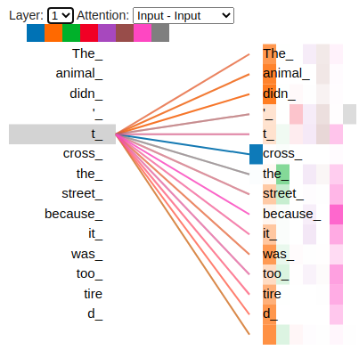

Pruning criterion
  Head no.
  1 2 3 4 5 6 7 8
Attention confidence (Voita et al., 2019)
Heads that assign large weights on average are more useful.
  Source: tensorflow.github.io/tensor2tensor/
Notes:
So far, we know 'what' we're going to prune - attention heads, and how we're going to do it - through the lottery ticket.
Now all that's left is ''which'' heads are going to be pruned.
This is a structural pruning problem and I wanted to use something more sophisticated than the magnitude of parameters and such.
I chose attention confidence as a criterion, introduced by Voita et al in 2019.
They said that attention heads that assign larger weights on average are more useful.
In the example on the right, the blue head is more confident in its decision rather than, for example the orange head, that creates a more spread out distribution.
Thus, I decided to prune the least confident attention heads from a model throught the lottery ticket method.

Slide 15
ITERATIVE pruning of attention heads
BASE TRANSFORMER
English → German (~4.5M sentences)
6 encoder layers, 6 decoder layers.
Remove 8 heads per pruning iteration.
After 14 iterations:
Model | Att. sparsity | BLEU WMT14-16 | WPS | Speed-up
Baseline | 0% | 30.4 | 897 | 1.00
Pruned | 78% | 30.1 | 2011 | 2.24
Notes:
Let's take a look at some preliminary experiments on a base transformer.
It is English to German tasks with a 6 to 6 encoder-decoder architecture.
I remove 8 of the least confident attention heads across the whole model per iteration.
After the loop of 14 of those iterations, about 80% of all attention heads were pruned.
As you can see here in the table, the model is 2.2 times faster at a small cost of -0.3 BLEU point in quality.
This is an impressive speed-up, but as I complained initially, this does not reflect the best optimisation practices out there. So...

Slide 16
WNGT2020 EFFICIENCY SHARED TASK
TINY TRANSFORMER
English → German (185M sentences)
6 encoder layers, 2 tied decoder layers, optimised.
Remove 3 encoder heads per iteration.
After 12 iterations:
Model | Enc. heads | BLEU WMT19 | WPS | Speed-up
Tiny | 8 8 8 8 8 8 | 41.5 | 8210 | 1.00
Tiny Pruned | 2 0 2 1 3 4 | 41.4 | 9518 | 1.16
Notes:
For this reason, I participated in WNGT2020 Efficiency Shared Task, which is about training an efficient machine translation model and competing with others for the most optimal speed and quality trade-offs.
Here we trained a tiny transformer with all the state-of-the-art optimisation tricks thrown at it. The decoder got reduced to two tied layers, we utilised knowledge distillation, shortlisting et cetera.
I focused on pruning the encoder only with 3 heads removed per iteration.
As you can see in the table, the highly-optimised model gets 16% faster on a GPU after pruning with only -0.1 BLEU difference.
This is a nice trade-off, given such tight optimisation environment, landing this model on the Pareto frontier in the task.

Slide 17
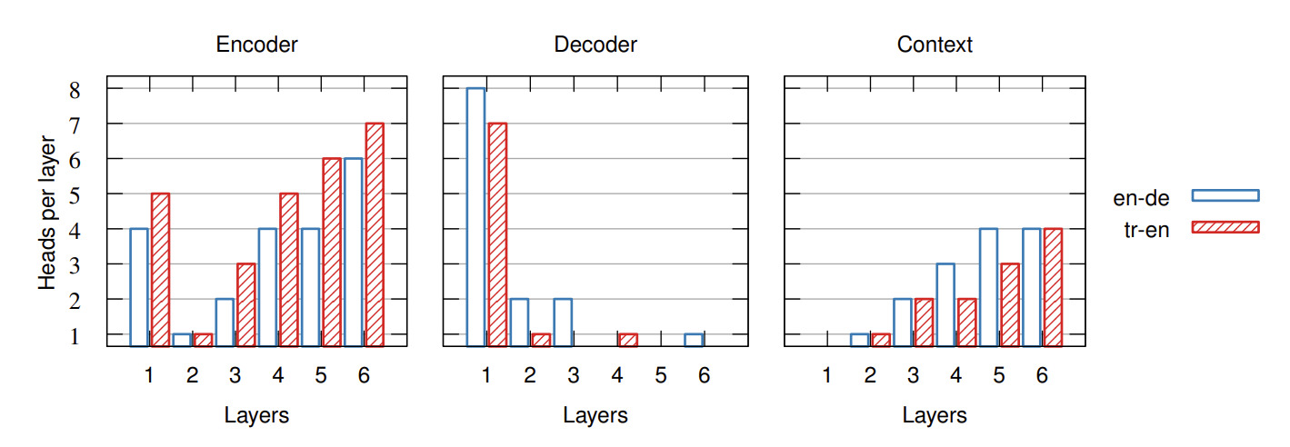

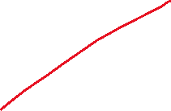

Attention distribution
Similar across languages!
Notes:
Across my experiments, I have noticed some sparsity patterns emerging for various language pairs.
In this case, for both English to German and Turkish to English, I have observed similar patterns.
For example, the encoder attention layers becomes U-shaped.
The decoder self-attention prefers to perform language modelling in the first layer and then quickly dispersing.
In contrast, the context attention arises in further layers in the ascending manner.

Slide 18
Conclusions
LOTTERY TICKET HYPOTHESIS
Structural!
Takes too long.
ATTENTION HEADS
Can be pruned.
Negligible change to quality.
NEXT WORK
Incorporate into training.
Feedforward layers?
Notes:
To conclude this research, I have shown that the Lottery Ticket Hypothesis can be applied structurally, in this case to prune attention heads.
Most attention heads can be removed at little to no damage to the quality.
Unfortunately, one of the disadvantages of this method is that it takes a long time to prune and train a single model.
In my following work I incorporate pruning into training to reduce the overall deployment time.
Moreover, I expand beyond the attention mechanism onto the feedforward layers as well.

Slide 19
GROUP LASSO
Notes:
Now that we have this out of the way, let's progress to the second part of this presentation.

Slide 20
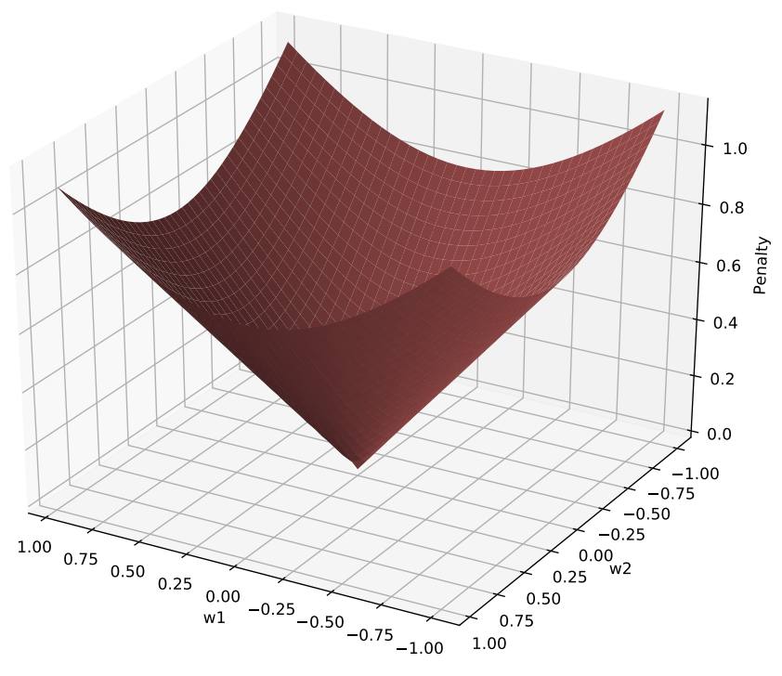
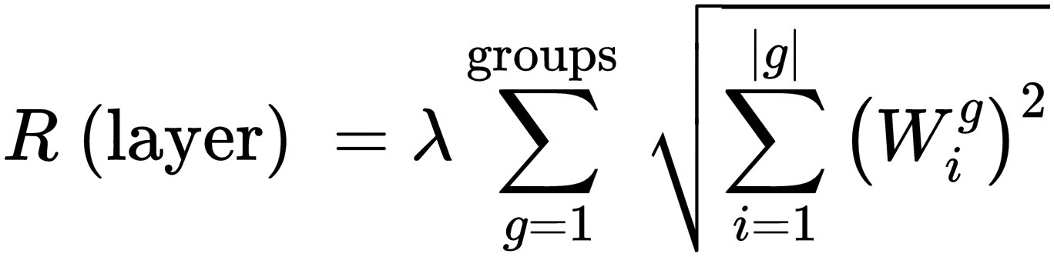
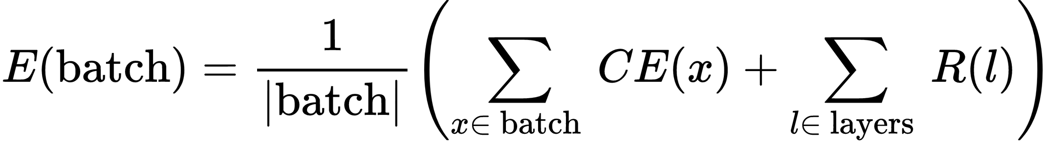
GROUP LASSO
(Yuan & Lin, 2006)
STRUCTURAL REGULARISER
A simple structural regulariser that zeroes out parameters together.
For parameters , group lasso is defined as:
PRUNE WHILE TRAINING
Easy to use with additional penalty cost.
Notes:
Group Lasso is a structural regulariser introduced in 2006 by Yuan and Lin.
It zeroes parameters together in groups by penalising the cost function accordingly.
As you can see in this visualisation, the group lasso penalty has this funnel shape which causes the gradient descent to fall into it and zero out parameters simultaneously.
The group lasso penalty applies the L2 norm over parameters within groups and the L1 norm onto the groups themselves.
The penalty is then added to the cross-entropy here, with the lambda scalar controlling the strength of pruning.
There is no loop and reset mechanism as regularisation prunes parameters as training progresses.
It is easy to use as it only requires additional penalty added to the cost function.

Slide 21
PRUNING schedule
1. Pretrain (25k BATCHES)
To avoid damage in early stages of training.
2. Regularise (250k)
Train with the group lasso regularisation.
3. Slice and converge (200k+)
Slice a model, train until convergence.
Notes:
Inspired by the previous research and my empirical experience, I designed the following pruning schedule.
Again, I pretrain a model to stabilise it and avoid damaging it prematurely.
Next, I train a model with regularisation turned on where parameters get zeroed out.
Finally, I slice the model structurally to make a smaller dense architecture.
Then, training continues until convergence.

Slide 22
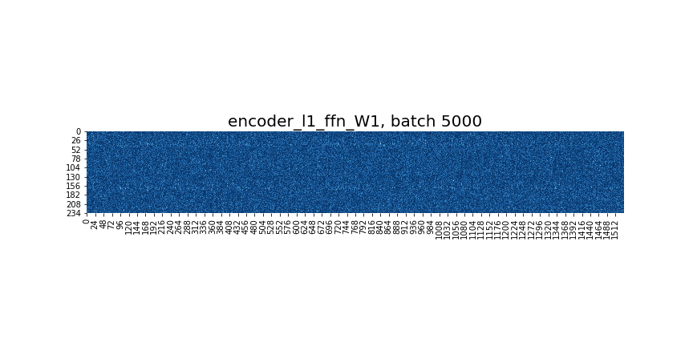
Group lasso in action!
DARK AREAS ARE PRUNED.
Notes:
This is what group lasso looks like in practice!
I applied it to feedforward layers to zero out individual neurons, which correspond to rows and columns in matrices.
In this visualisation, you can see columns disappearing as updates progress.
We can now take this layer, remove zeroed out dark areas, and squish this matrix like a sandwich.
It will not affect the calculations, but we will have much smaller matrices, and the model will remain dense.
Naturally, smaller matrices mean faster matrix multiplications.

Slide 23
PRUNING BOTH ATTENTION AND FFN LAYERS
Shifting layers to encoder and pruning it gives best results.
 |  | Baseline | Pruned
Quality | BLEU | 38.2 | 37.9
 | COMET | 49.5 | 49.6
Efficiency | Att. sparsity | 0% | 48%
 | FFN sparsity | 0% | 63%
 | WPS | 1930 | 2918
 | Speed-up | 1.00 | 1.51
TINY TRANSFORMER
English → German (45M sentences)
„12-1” architecture, optimised.
1536 FFN nodes, 8 attention heads.
Notes:
I proceed with the experiments on the optimised model, this time with 12 to 1 encoder-decoder architecture.
I focus on the encoder only, pruning both attention and feedforward layers.
I apply structural regularisation over them on a neuron level.
Feedforward layers are straightforwardly sliced, while the attention heads are removed if at least half of their connections are dead.
As you can see in the table on the right, the results are really promising.
At no change in quality, this model gets 1.5 times faster by removing more than half of the parameters from the encoder.

Slide 24
Pruning is better than training from scratch
TINY TransformeR
English → German (45M sentences)
„6-6” architecture, optimised.
Pruning all feedforward layers.
Model | Baseline | λ = 0.1 | λ = 0.15 | λ = 0.2 | λ = 0.3 | λ = 0.4 | λ = 0.5 | λ = 1.0
Sparsity | 0% | 31% | 55% | 69% | 81% | 87% | 91% | 98%
COMET Pruned | 54.8 | 55.7 | 54.7 | 53.8 | 52.9 | 52.8 | 51.9 | 49.6
COMET Reinit | — | 53.8 | 53.3 | 52.3 | 51.5 | 51.4 | 49.7 | 49.1
Speed-up | 1.00 | 1.12 | 1.26 | 1.34 | 1.42 | 1.49 | 1.52 | 1.61
Notes:
In the previous slide, I have shown that the group lasso makes models more compact and faster at no change in quality.
The question is: do we even need to bother with this pruning business?
Or does it serve more as an architecture search method, and we can use the same architecture from the start?
I take the same model as before, but this time with 6 to 6 encoder-decoder architecture.
I prune this model to various degrees with different lambda scalars.
Then, I reinitialise those architectures and train them from scratch.
This experiment compares how identical models behave when carefully pruned and straightforwardly trained like that from the beginning.
As you can see in those middle rows that compare COMET scores, the models trained from scratch constantly underperform.
It means that careful pruning results in better quality and is crucial for performance.

Slide 25
WNGT2021 EFFICIENCY SHARED TASK
TINY Transformer
English → German (508M sentences)
„12-1” architecture, optimised.
Speed on 1 CPU core. Quantised to 8-bits.
Model | Att. sparsity | FFN sparsity | BLEU WMT21 | Time | Speed-up
Tiny | 0% | 0% | 27.6 | 19.2 | 1.00
Tiny Pruned | 60% | 59% | 26.3 | 11.6 | 1.66
Tiny Pruned + Quantised | 60% | 59% | 26.0 | 7.1 | 2.70
Notes:
Another year, another Efficiency Shared Task to test my research in practice.
I selected the model with „12-1” encoder-decoder distribution as it has proven to be a fast and reliable choice.
Again, I prune both attention and feedforward layers.
This time, we also quantise the models to 8-bits.
This competitive setup made our robust model 2.7 times faster at 1.6 BLEU loss through structural pruning and quantisation.

Slide 26
Conclusions
GROUP LASSO
Works in an optimised setup.
Trains and prunes in one pass.
REGULARISATION SCHEME
Pruning early into training.
Significant inference speed-up.
NEXT WORK
Target disposable layers.
Address quality bottlenecks.
Notes:
To conclude my work on group lasso, I have shown that it works on transformer architectures in an highly optimised setup.
I prune both feedforward and attention layers in the early stages of training, which results in significant inference speed-up.
Next, I want to improve upon this work by targeting obsolete layers specifically and avoiding those deemed too important.

Slide 27
AIDED REGULARISATION
Notes:
Finally, let’s look at my lastest work on the aided regularisation.

Slide 28
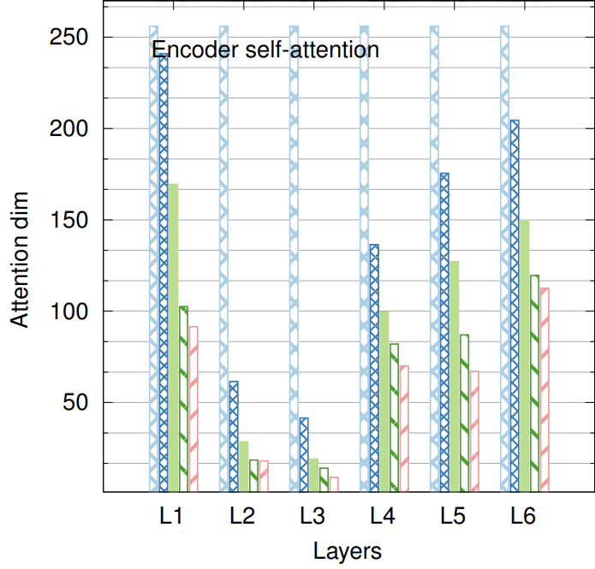
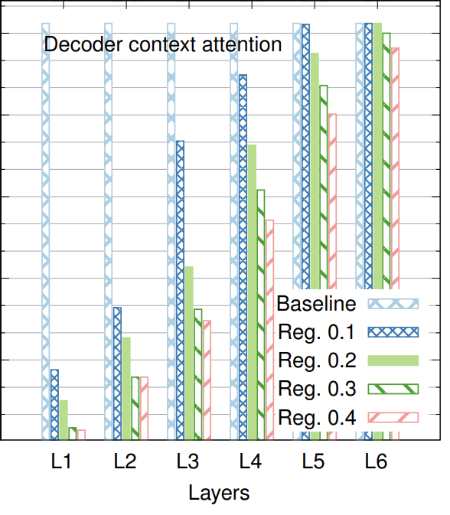



All layers are penalised the same way...
While some are eager to be pruned...
The others refuse to!
Notes:
In a typical regularisation I have shown you so far, all layers are penalised in the same manner.
However, when you look at how regularised models behave, some layers get pruned quite aggressively, while others refuse to do so.
The second case is quite problematic since forcing a model to prune those layers affects the translation quality.
Ideally, we want to focus our pruning efforts where it is actually wanted and avoid it where it is not.

Slide 29
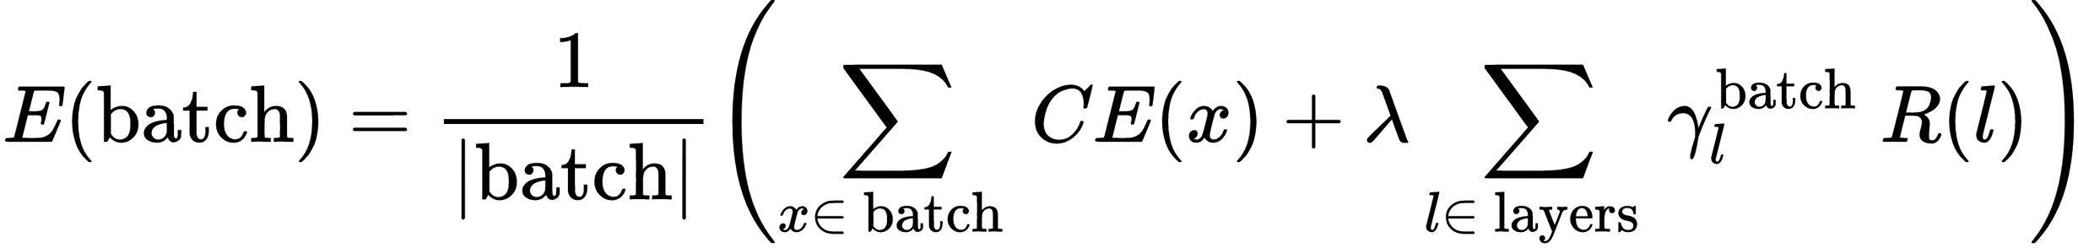
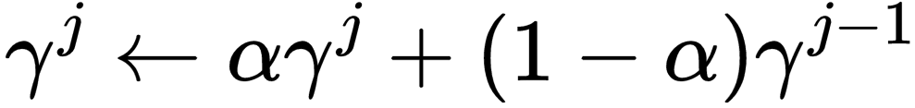

AIDED
REGULARISATION
IDEA: SCALE PENALTIES PER LAYER!
INDIVIDUAL SCALARS
Scale penalties up or down per layer.
EXPONENTIAL SMOOTHING
Update scalars during training and smooth them.
For update j:
EXTERNAL INFORMATION
Aid the scaling function with gradients, parameters, et cetera to create a custom scaling scheme.
Notes:
Let me introduce you to an aided regularisation method.
In comparison to a standard regularisation, this regulariser includes an additional scalar gamma, highlighted in red. The idea is to scale penalties for each layer.
These scalars are updated after each batch update and exponentially averaged over training duration.
It is called aided regularisation becase the gamma function is aided by external information.
This could be, for example, magnitude of gradients or parameters, which can steer regularisation accordingly.

Slide 30
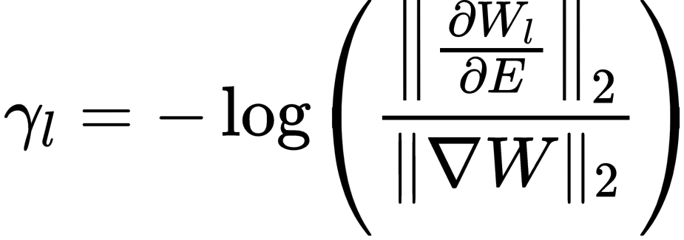
Gradient-aided regularisation
Layer gradients
Global gradient norm
Small gradients = prune
Potentially not learning much, thus a good candidate.
Gradients decrease naturally
Scale down by a global norm!
Problematic?
Using penalised gradients in a cost function? 😱
Let’s do it anyway to avoid backpropagating twice.
Notes:
In this presentation, I will focus on gradient-aided regularisation.
This regularisation scheduling assumes that if a layer has consistently small gradients, it does not learn and thus is a good candidate for pruning.
The reverse is also true: a layer should be left alone if its gradients are high or even increasing.
Naturally, gradients decrease during training by design. A layer shouldn't be penalised more just for that reason.
The gradient-aided gamma function is the L2 norm of local gradients here, scaled down by the global gradient norm, with the minus log function applied over it.
Ideally, gradients should be backpropagated without regularisation penalties first to scale those penalties. Nevertheless, I will use the available gradients as an approximation to avoid backpropagating twice.

Slide 31


RESULTS
 | Pruned
 | FFN | Heads
Enc. L1 | 1507 | 7
Enc. L2 | 1536 | 3
Enc. L3 | 649 | 4
Enc. L4 | 367 | 7
Enc. L5 | 256 | 5
Enc. L6 | 161 | 2
Enc. L7 | 64 | 2
Enc. L8 | 38 | 0
Enc. L9 | 44 | 0
Enc. L10 | 182 | 0
Enc. L11 | 1532 | 0
Enc. L12 | 1536 | 4
Dec. L1 | 1536 | 8
Sparsity patterns more evident than before.
Pruning is better than training from scratch.
Significant speed-up at small quality drop.
 | Baseline | Pruned
BLEU | 38.2 | 37.8
COMET Pruned | 49.5 | 48.3
COMET Reinit | — | 44.2
WPS | 2111 | 3501
Speed-up | 1.00 | 1.66
Notes:
Let us take a look at some of the results. I keep the regularisation scheme unchanged and only modify the cost function to scale penalties per layer.
The table on the right shows the distribution of parameters for the baseline and the pruned model. Overall, the sparsity patterns manifest more clearly than before.
Despite being penalised, the single decoder layer has been untouched.
The middle encoder layers has been aggressively reduced instead.
On the left, you can see the quality and speed evaluations of those models.
The model pruned with the aided regularisation is 66% faster at a small drop in quality.
It is worth noting that the same architecture trained froms cratch underperformed by more than 4 COMET points, clearly making structural pruning superior.

Slide 32
SNIP AND REJUVENATE
 | Pruned
 | FFN | Heads
Enc. L1 | 1536 | 8
Enc. L2 | 1536 | 8
Enc. L3 | 1536 | 8
Enc. L4 | 1536 | 8
Enc. L5 | 1536 | 8
Enc. L6 | 0 | 8
Enc. L7 | 0 | 0
Enc. L8 | 0 | 0
Enc. L9 | 0 | 0
Enc. L10 | 0 | 0
Enc. L11 | 1536 | 0
Enc. L12 | 1536 | 8
Dec. L1 | 1536 | 8
Reduce encoder depth from 12 to 7.
Recovers back to the baseline quality.
Reduced depth still makes a model faster.
 | Baseline | Pruned
BLEU | 38.2 | 38.3
COMET | 49.5 | 50.2
WPS | 2111 | 3054
Speed-up | 1.00 | 1.45
Notes:
There has been some research insight into 'pruning and rejuvenating' parameters improving the robustness of a model and, in turn, its quality.
I repeat the experiment from the previous slide, but this time, I reduce the depth of a model by removing the most pruned layers.
At the same time, I allow other layers to rejuvenate back to their full capacity.
The model recovers completely quality-wise back to the baseline level, slightly outperforming it.
At the same time, it is 1.45 times faster with the architecture now being 7 to 1 encoder-decoder instead of 12 to 1.

Slide 33
Conclusions
AIDED REGULARISATION
Pareto optimal.
PRUNING SCHEME
Fast, targets specific layers.
FUTURE WORK
New scaling functions?
Publish 😊
A novel approach.
Stable quality, faster inference.
Notes:
To conclude this research briefly, I introduced a novel regularisation approach that scales penalties per layer, resulting in Pareto optimal architectures.
This regularisation scheme provides fast pruning that targets specific layers to reduce the depth of a model.
In turn, inference gains a significant speed boost at small or no damage to translation quality.
In terms of future work, there are infinite ways to create new scaling functions for this regularisation method.
Also, I would like to publish this research down the line.

Slide 34
Conclusions
Filled the gap on fast sparsity in NMT.
Structural pruning is easily achievable and boosts inference speed at no quality cost.
Pushed the state-of-the-art Pareto frontier.
Notes:
My thesis challenged the knowledge gap on fast sparsity in the context of NMT with empirical evidence.
Through various techniques, I have shown that structural pruning is easily achievable in NMT and leads to a substantial boost in inference speed at no quality cost.
The resulting models push the state-of-the-art Pareto frontier.

Slide 35
THANK YOU!
Maximiliana Behnke
maximiliana.behnke@ed.ac.uk
Notes:
I would like to thank you for attending this presentation and being here with me.
If you have any questions, do not hesitate to ask me anything.
Thank you!

